Slide 2
SQL Server Administration
made easy with dbatools
Rob Sewell - Sewells Consulting Ltd

Slide 3

Rob Sewell
Bearded Consultant, Automator,
Trainer
Consultant Sewells Consulting Ltd
beard.media/book dbachecks PowerShell & Data Community
/robsewellsqldba
@sqldbawithbeard
SQLDBAWithABeard.com

Slide 4

What are we going to talk about?

Slide 5


Slide 6
Problems we’re aiming to solve
Reduce Hesitations about PowerShell
Increase Confidence about Script Development
Whether it’s about security concerns or feeling like PowerShell is too different or hard
You’ve got a whole community that’s excited to help!
Encourage Community Contributions
Encourage Best Practices
Join Microsoft and the community in the global open source movement
Things we wish we knew years ago, all condensed
Notes:
EACH OF US TAKE ONE

Slide 7
SQL PowerShell History
(Condensed)

Slide 8
Condensed SQL PowerShell history
First Release - SQL Server 2008
5 commands + Provider
Snapin and Minishell
SQL Server 2012
33 commands
Module
SQL Server 2014
45 commands
Notes:
2008 – PowerShell Snapin and Minishell
2012 – introduced the SQLPS module
44 Months
Mostly Availability Group
2014 - 6 years into it and we’ve only got 45 commands

Slide 9
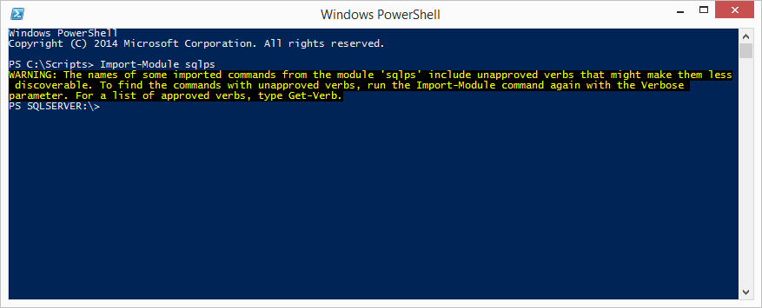
Condensed SQL PowerShell History
Notes:
Tab-completion didn’t work
Invoke-SqlCmd was buggy
-WhatIf actually performed commands
SQLPS was slow to load
SQLPS changed the directory unexpectedly
SQLPS used unapproved verbs
Other platforms offered 700+ cmdlets

Slide 10

Condensed SQL PowerShell history
SQL Server 2016, 2017 and Beyond
A new name
Dedicated engineer
Now separate from SSMS install
PowerShell Gallery
Continuous releases
Currently at 98 cmdlets
Notes:
Toy Story Reference ☺
The SQL Server team hired a dedicated PowerShell engineer – We love Matteo – even if we aren’t sure how to pronounce his surname
Microsoft began taking Connect Items (suggestions + bug reports) seriously
https://social.msdn.microsoft.com/Forums/en-US/728f562f-0600-432b-aaab-1decc406d6d8/submitting-defect-reports-and-suggestions?forum=sqltools
SQLPS was renamed to SqlServer
Made it easier to do REGULAR RELEASES!
Initially these were monthly releases associated with SSMS
But then they were doing two a month of SSMS
March 2017 - Separated from SSMS install with the SSMS 17.0 release and available from the PowerShell Gallery – no need for massive download (20Mb versus 700Mb ) and quicker releases –easier to update
Rob, discuss how community and Microsoft came together

Slide 11
PowerShell Syntax
PowerShell ≈ T-SQL
Notes:
Should be fu nctionality?

Slide 12
Querying
T-SQL
PowerShell
SELECT
FROM
JOIN
WHERE
GROUP BY
ORDER BY
Select-Object
Piping or looping
Join-Object
Where-Object
Group-Object
Sort-Object
Notes:
So breaking down the basics, here’s the list.
What when we go by the shortnames, its may be even clearer.

Slide 13
Aliases
T-SQL
PowerShell
SELECT
FROM
JOIN
WHERE
GROUP BY
ORDER BY
select
| or %
join
where or ?
group
sort
Notes:
So we can see that order by and from are a little bit wonky, but otherwise this is somewhat familiar territory.
And that’s what I want you all to understand, that your set based filtering and projections are welcome and awesome skills, and they apply fairly directly to things in PowerShell.
T-SQL has AS, we have Set-Alias
Address RBAR with PS (% = ForEach-Object) and how it’s NBD

Slide 14
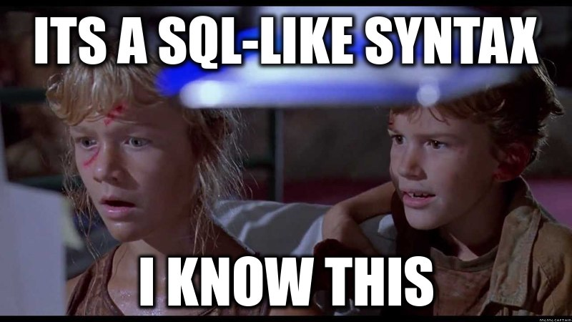
Powers you already know
Notes:
Remember, it’s a SQL like syntax, you know this.
Alright, let’s dive into the various commands, break them down a little bit, and show off some interesting possibilities.
First, we are going to discuss Select-object

Slide 15
Select-Object
# Get me the default output
$db
# Get me everything!
$db | Select-Object *
# Informal, select one property
$db | Select Name
# Prim and Proper, select a property using named parameters
$db | Select-Object -Property Name, Size
# Sometimes avoiding the pipe can be faster, check for -InputObject
Select-Object -InputObject $db -Property Name
Notes:
So select-object’s syntax (if you are new to powershell) can be a little daunting, but the truth is that most things in powershell follow a set of rules, and there are are always wonderful examples in the help documentation ☺
Select-Object or Select for short can filter and project properties from objects and pass whole objects or portions through the pipeline for you to further manipulate.
Just like a SQL statement, you specify a list of “columns” or properties, and those will be returned.
Unlike a SQL Statement, the Select-Object command does not allow things like formatting directly in the selection stage without a little additional trickery.

Slide 16
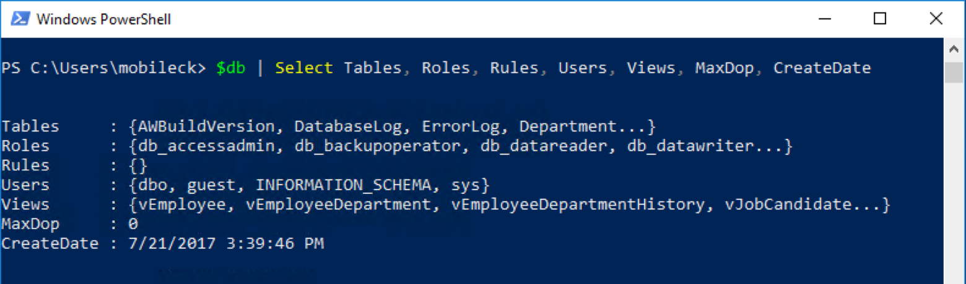
Select-Object
Notes:
One thing you will find repeated in our sessions is that things that would be generally a bad idea either difficult in writing, composing, maintaining, or at the very least or at least performance inhibiting in T-SQL may not be a bad idea in PowerShell and visa-versa.
You can see in this command piping the database object to Select-Object we get a set of objects which would not be nearly as clear to get at in the TSQL versions, and would require a decent amount of additional code (this is 2016, so MaxDop is on the database level)
The Select-Object cmdlet has the ability to automatically understand the length of every object and it is trivial to index a specific position in a list, which would often require keys or row numbering in TSQL.
Using a combination of –First, -Skip (which skips the first N records) and –Last, you can easily sample your results and make sure they are what you expect, or even use the –Index parameter to give a list of items you would like extracted.
Also unlike TSQL, PowerShell often has complex nested types (if you do this in SQL son I feel bad for you, denormalize or get out) and the –ExpandProperty parameter is a really nice way to automatically extract the contents of nested collections or in some cases when a property is returned instead of a value.
This is a common operation when you want to dynamically get the value of something that returns an object instead of a value, simply select expanding and you don’t have to do some complex assignment dance.
One thing that I think is worth explaining which is frankly a bit easier in T-SQL than PowerShell is calculated properties, similar to concatenation or additional functions run on projected data in T-SQL.

Slide 17
Select-Object
-First
-Skip
-Last
-Index
-ExpandProperty
Calculated Properties
Notes:
One thing you will find repeated in our sessions is that things that would be generally a bad idea or at least performance inhibiting in T-SQL may not be a bad idea in PowerShell and visa-versa.
The Select-Object cmdlet has the ability to automatically understand the length of every object and it is trivial to index a specific position in a list, which would often require keys or row numbering in TSQL.
Using a combination of –First, -Skip (which skips the first N records) and –Last, you can easily sample your results and make sure they are what you expect, or even use the –Index parameter to give a list of items you would like extracted.
Also unlike TSQL, PowerShell often has complex nested types (if you do this in SQL son I feel bad for you, denormalize or get out) and the –ExpandProperty parameter is a really nice way to automatically extract the contents of nested collections or in some cases when a property is returned instead of a value.
This is a common operation when you want to dynamically get the value of something that returns an object instead of a value, simply select expanding and you don’t have to do some complex assignment dance.
One thing that I think is worth explaining which is frankly a bit easier in T-SQL than PowerShell is calculated properties, similar to concatenation or additional functions run on projected data in T-SQL.

Slide 18
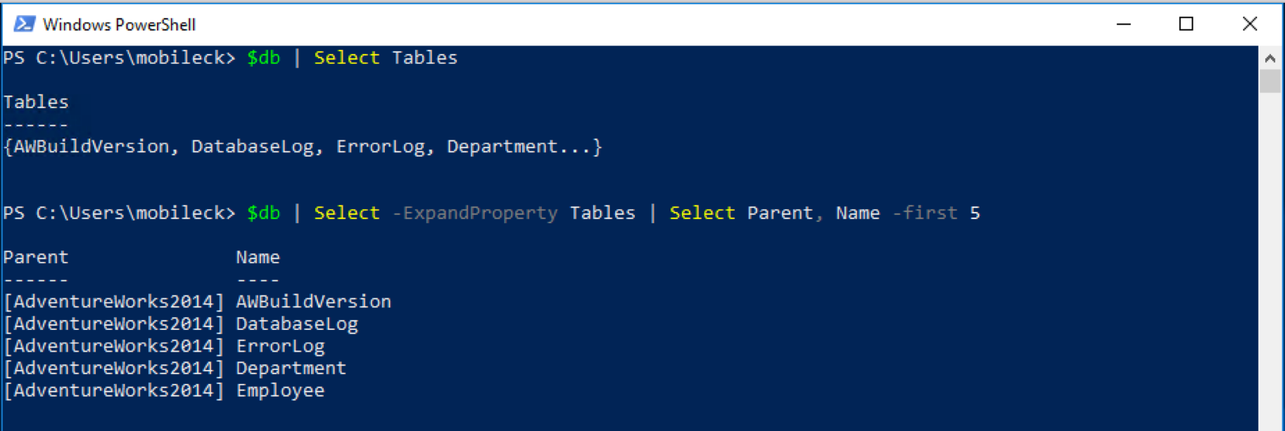
Select-Object -ExpandProperty
Notes:
One thing you will find repeated in our sessions is that things that would be generally a bad idea either difficult in writing, composing, maintaining, or at the very least or at least performance inhibiting in T-SQL may not be a bad idea in PowerShell and visa-versa.
You can see in this command piping the database object to Select-Object we get a set of objects which would not be nearly as clear to get at in the TSQL versions, and would require a decent amount of additional code (this is 2016, so MaxDop is on the database level)
The Select-Object cmdlet has the ability to automatically understand the length of every object and it is trivial to index a specific position in a list, which would often require keys or row numbering in TSQL.
Using a combination of –First, -Skip (which skips the first N records) and –Last, you can easily sample your results and make sure they are what you expect, or even use the –Index parameter to give a list of items you would like extracted.
Also unlike TSQL, PowerShell often has complex nested types (if you do this in SQL son I feel bad for you, denormalize or get out) and the –ExpandProperty parameter is a really nice way to automatically extract the contents of nested collections or in some cases when a property is returned instead of a value.
This is a common operation when you want to dynamically get the value of something that returns an object instead of a value, simply select expanding and you don’t have to do some complex assignment dance.
One thing that I think is worth explaining which is frankly a bit easier in T-SQL than PowerShell is calculated properties, similar to concatenation or additional functions run on projected data in T-SQL.

Slide 19
Calculated properties
$login | Select-Object -Property Name + “test” # This fails.
# Technically would work but kludgy
($login | Select-Object -ExpandProperty Name) + "test"
$login | Select-Object -Property Name, @{
# Specify your column's name
Name = "Formatted Column";
# Takes a script block to evaluate
Expression = { " $($_.Name) test" };
} # Idiomatic
Notes:
The first example is something I did a lot when I started in PowerShell, and it’s because I was missing the fundamental concepts.
The property name isn’t itself a thing, just a list being put into another function, and that function has a special syntax if you want to dynamically modify its output.
SO
Specifically, you have to pass a hash table with specific values, and the Select-Object command will understand you have to use a Calculated Property.
You can do this with any values you want, so if you find yourself saying “I need to join this” consider for smallish sets a calculated property could even be a lookup into another object, it’s a ScriptBlock so the possibilities are almost endless.
Alright, so we have a vague notion of how to take an object, find its properties, use select-object, project some of those properties, and we can even format it to boot.
What we haven’t really talked about is that little vertical line up there, called the pipe.

Slide 20
Piping -or looping
$db | Select-Object * # Pass $db output to the Select-Object command, you can use anything but the format- commands multiple times
$db | ForEach-Object { $_ } # and foreach item, return the database
$db | % { $_ } # same as above
foreach ($db in $databases) { $db } # same as above
while ($condition) {} # While Boolean condition do ScriptBlock
for ($i=0; $i -le 100; $i++) { $i } #0-99 display $i and increment it
do { $i } while ($condition) # Do while $condition is $true
do { $i } until ($condition) # Do until $condition is $true, I usually avoid this one.
Notes:
Piping and looping are next up on the docket, and they basically replace the FROM idiom in T-SQL.
Effectively, if you want to operate on an object in a general way to project and filter data, you will generally be using one of these approaches (though C# does allow further interesting options not listed here.)
In piping, we pass the output of objects into the inputs of commands, and the pipe has some rules we will talk about later which automagically connect the dots of how; the pipe also allows any number of select/where/etc in the pipeline, just like you can subquery infinitely in a SQL statement (though in both cases you might be faffing a bit.)
With looping (which if you’ve written most other languages this will be review time) in Powershell you can pipe the object to a foreach, write an explicit foreach, or use one of the provided loops.
For most dba related tasks I find foreach to be my favorite non pipe based loop, but its really user’s choice.
We wont spend much more time on these except to talk about the piping rules (in case you have a command through a tiz on you)

Slide 21
Pipe rules
How does Stop-Process know?
Get-Process -Name powershell | Stop-Process -WhatIf
Parameter Binding
Bind parameter by Value with same Type (No Coercion)
Bind parameter by PropertyName with same Type (No Coercion)
Bind parameter by Value with type conversion (Coercion)
Bind parameter by PropertyName with type conversion (Coercion)
Thanks Boe Prox!
https://mcpmag.com/articles/2015/05/20/functions-that-support-the-pipeline.aspx
Notes:
PowerShell actually has pararmeter binding rules which determine how the output of one command or object is read by the input of a second.
I totally stole this list from Boe Prox, who is a wizard of powershell such that I fear speak his name, please buy his book.
Summed up, the output of Get-Process –name powershell looks like a bunch of values with various column headers, and the object has the type of [System.Diagnostics.Process]
PowerShell takes a look and see’s the output of that object matches the first parameter input of the Stop-Process command with the –InputObject validating the Process[] type, if you want to check this out you can use the Trace-Command cmdlet and look for the ParameterBinding Information call, you should see bind arg [System.Diagnostics.Process[]] to param [InputObject] Successful.
These rules are not things you need every single day, especially when working with a well designed module like dbatools.
If your functions are “advanced functions” and support the pipeline, and have sane input and output object types, you will find that powershell mostly automagically figures it out for you.
If you get really stuck trying to pipe things or are getting some confusing output, keep the previous rules in mind and pipe your object to Get-Member.

Slide 22
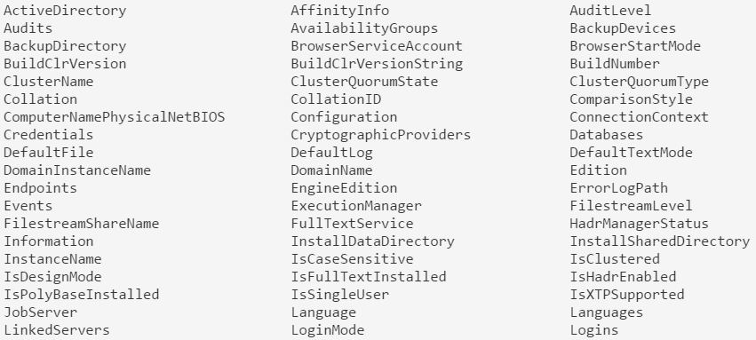
Get-Member introspection
Connect-DbaInstance -SqlInstance localhost | Get-Member -MemberType Properties | Format-Wide -Column 3
Notes:
It’s the automatic “Tell me what this thing does” tool of powershell, and its invaluable when navigating unfamiliar territory with PowerShell.
In general, Methods are things the object does (verbs) and Properties of various types are things the object is (data).
Here you see my asking the object that is returned from Connect-DbaSqlSedrver “What properties do you have formatted in 3 columns?”
It may seem a bit daunting at first, but when you consider that this is the server object that SSMS does all its work through, it starts to make sense.
You might see some interesting ones, like Databases, Paths, IsSingleUser, Credentials, all sorts of fun properties to be able to immediately inspect!
With this tool in mind many times the answer may be obvious when you are trying to solve a problem (or at least its clear what the next step to unravel the puzzle is) but you might want to just check out the MSDN page on that .NET type to get some additional information if you are getting thrown for a loop.
Many of the times the PowerShell documentation is good, but with some basic PS knowledge you can take a look at the properties and methods of the .NET type, and often times they have decent examples right up front (many if not in PowerShell, at least in C#.)
Alright, moving back onto the train, let’s take a look at Join-Object.
____
This slide also outlines something awesome about PowerShell that drove me crazy with VBScript. Like $sql, this command spans more than one line.
Using escape ` can also allow you to span more than one line by literally escaping a \r\n

Slide 23
Where-Object
$servers | Where-Object {
$PsItem.Databases -Contains ‘AdventureWorks'
} # Current item in pipeline like A wildcard
$servers | Where-Object {
$_.ClusterName -like ‘sql01*’ -or $_.ClusterName -like ‘sql-01*’
} # -and like wildcard B, chain all you want.
$servers | Where-Object {
$PsItem.Databases.Count –gt 10 -or $_.Logins.Count –gt 10
} # Using $PsItem or $_ is interchangeable >= ps3.0
Notes:
Where-object is the predicate filter for PowerShell, and you can use it to great effect.
Just like TSQL
This would be a good place to talk about fancy quotes and regular quotes and how PS recognizes both
“Databases” is a rich object. How does it contain “Contain?” ToString()!

Slide 24
PowerShell operators
Think parameters
-Contains
-In
-Is
-EQ
-GE
-GT
-LT
-Like
-Match
-NE
-IsNot
-NotContains
-NotIn
-NotLike
-NotMatch
-And
-Or
-Not
Notes:
PowerShell does not use mathematical operators you are used to in the context of comparisons, it does for assignment.
That’s because classic comparison operators like greater than or less than are actually classic shortcuts for shell redirection operators, and so when PS was conceived they thought that as operators were effectively parameters to a function, why not just make it prefixed with –
This also helps a little bit with readability of some code, its much harder to mistake –gt for –lt than < for > in my experience.
The is/isnot compares types
The like compares wildcard comparisons
The match uses regex
Everything else seems pretty straightforward, and you can string them together with –and –or and –not, use parens
Again, you can use where multiple times in a pipeline, so if you want to filter, pipe to a command, and filter, feel free to.
With the where clause mostly cleared away, let’s take a look at Group-Object.

Slide 25
Group-Object
# Return Database counts grouped by Owner. Get-DbaDatabase . | Group-Object -Property Owner
# Return database counts grouped by Compatibility Level.
Get-DbaDatabase . | Group CompatibilityLevel
-- Group-Object is somewhat equivalent to
select col as Name, COUNT(col) as Count, AllColumValuesAsXML
FROM tbl
group by col
-- But works on objects
Notes:
Group-Object is a nice tool in the PowerShell toolbox, but unlike the T-SQL version, its not a 100% critical tool for getting information as PowerShell can determine a lot of aggregate values in loops which would generally be a bad idea in T-SQL.
Here we can see some process grouping, and this is my preferred way to use Group-Object, which is to take some output which may have many rows and quickly categorize them for me and aggregate by various types.
You can think of this somewhat analogous to the following TSQL query, but because it’s not constrained by the same rules as TSQL, it actually returns a 3rd column named Group which actually contains objects which are the counted results. You’d have to do some disgusting TSQL XML querying to get the same result of a column.

Slide 26
Sort-Object
# Default sorting of jobs, pretty meh
Get-DbaAgentJob . | Sort-Object
# Get most recent ran jobs first
Get-DbaAgentJob . | Sort-Object -Property LastRunDate -Descending
# Guess what this will do?
Get-DbaAgentJob . | Sort-Object OwnerLoginName -Unique
Notes:
Sort-Object is a nice little item to sort your objects, but you need to be careful because just like Group-Object, at first it may remind you of T-SQL commands, but it obeys a completely different set of rules.
By default sort-object has a little powershell magic (based on the same formatting files) to determine what it will sort on, but being explicit is always better than implicit when it comes to maintaining code.
There are a few parameters which we would recognize from the t-sql realm that we will check in a second, but I want to caution you that when naively writing sort code, things are not always what you expect.
For instance, what do you think the third command does?
(it returns a single line for each agent job by returning it as the first item in how its lists the processes out in the previous pipeline, output is bizarre for useful stuff, but this is programming damnit, not useful stuff!)

Slide 27
Finish line: console behaviors
Properties may be truncated
Properties re-arranged from your expectations
Total count of properties displayed change
Output you expect missing
Output in an unexpected order
Output mixed with other colors, warnings, errors, debug messages, etc.
Notes:
When new to powershell (or even not new tbqh) you may run into some stuff behaving oddly in your powershell.
What you need to know is a little deeper into how powershell goes from code to displayed on the screen.

Slide 28
Console behaviors
Streams – Host, Output, Verbose, Error, Warning…
Console Host
Console Size
Object Properties Projected
PowerShell Version
*.format.ps1xml
Notes:
When new to powershell (or even not new tbqh) you may run into some stuff behaving oddly in your sessionm.
What you need to know is a little deeper into how powershell goes from code to displayed on the screen.
Talk about each influence a bit.
In many cases, this the type of behavior that can cause interesting results you may not expect.
Depending on the streams, the size of the console host, how the host is implemented, the format files, the powershell version, and the properties and their types you output, you can have a very different experience.
I have written code in PS in the ISE, the console, and visual studio code and seen the output come out three different ways.
Knowing that, keep in mind you can always force behaviors you want, it just may take more effort than you are used to in other languages.

Slide 29
Forcing output
# When you write:
$Output = "A simple sentence."
Write-Output $Output
# It’s really more like:
$Output = "A simple sentence."
Write-Output $Output | Out-Default | Out-Host
# When you are not interested in any junk.
$Error[0] | select * | Format-List -Force
Notes:
If you want to force an object to output (instead of being potentially unioned) you may have to pipe it to Out-Default.
If you are really sick of this formatting bull crap, just use the select * | fl -force magic I love so much (great for error messages)
If you cant get the output with these two tricks, try beginning assigning the output of operations to variables (or $null if you don’t care about the output), there are some cases where object output destroys the console output.
And with that, we wrapped up our talk on PowerShell console quirks, you should be more ready now to take on output from dbatools commands and craft them to your needs!
Awesome.

Slide 30
Bonus: SQL Variables in PowerShell
$sql = "SELECT SERVERPROPERTY('MachineName') AS ComputerName,
ISNULL(SERVERPROPERTY('InstanceName'), 'MSSQLSERVER') AS
InstanceName, SERVERPROPERTY('ServerName') AS SqlInstance,
t.session_id AS Spid from $table $where"
Notes:
One of the things I wish I knew when I first started powershelling was that you do not need to use any special multi-line strings.
Now, while you should not program a web application like this, these kind of simple string formatting things make lives easy.
The coolest thing about it? Those variables are expanded at runtime, so you can absolutely store these SQL queries in constant files or in other ways to cleanly separate your code.
Enjoy that tidbit!

Slide 31
PowerShell vs. T-SQL
Know when to say when

Slide 32
When to use PowerShell
Many instances
… or just one ;)
Multiple databases
Multiple tables
Multiple logins
Multiple jobs
Multiple everything
Instead of sp_MSforeachdb or sp_MSforeachtable

Slide 33
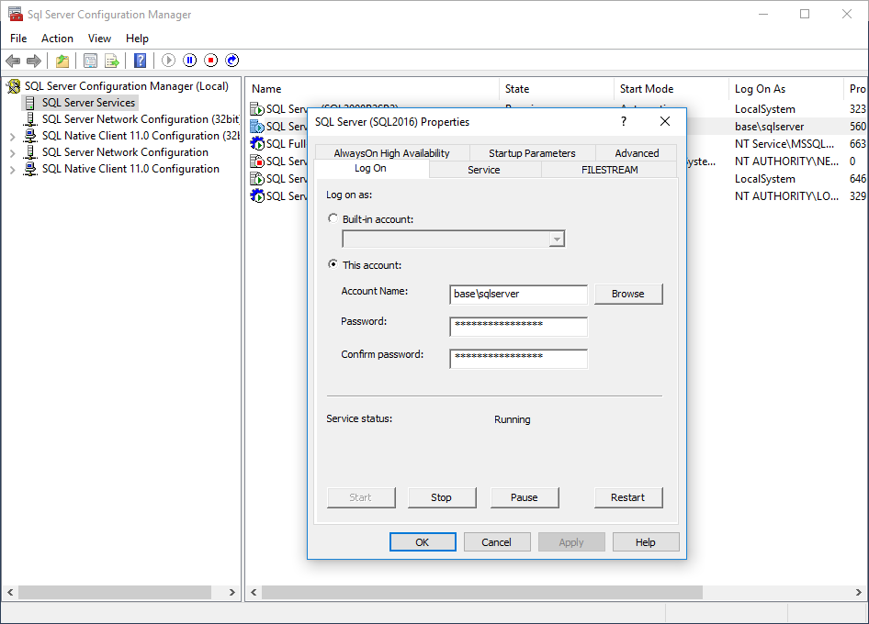
PowerShell ❤️ SQL Server
Developing for different SQL Server versions
No need to know underlying tables between versions
Performing tasks in SQL Server Configuration Manager
Notes:
Let’s talk about SMO

Slide 34

PowerShell ❤️ Windows
Performing related Windows administrative tasks
Certificate Management
Registry access
Active Directory
Service Principal Names (SPNs)
Event Viewer
Power Plans
Filesystem

Slide 35
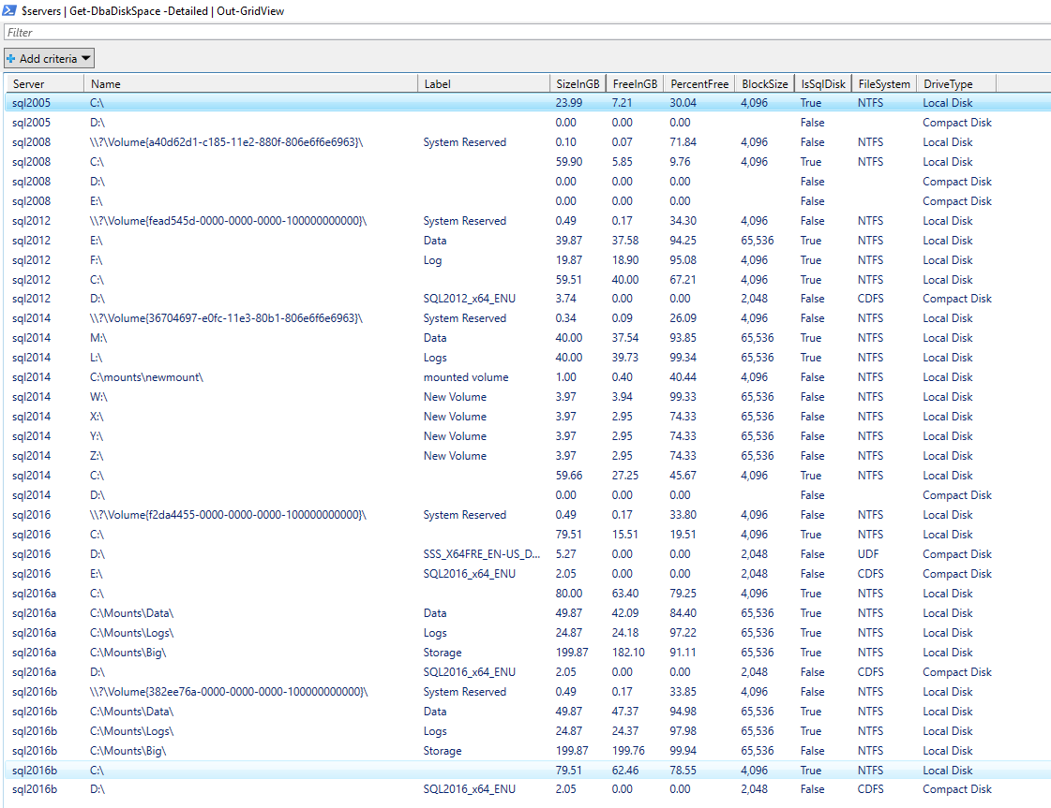
PowerShell ❤️ the Filesystem
Notes:
ASP.NET Hammer

Slide 36
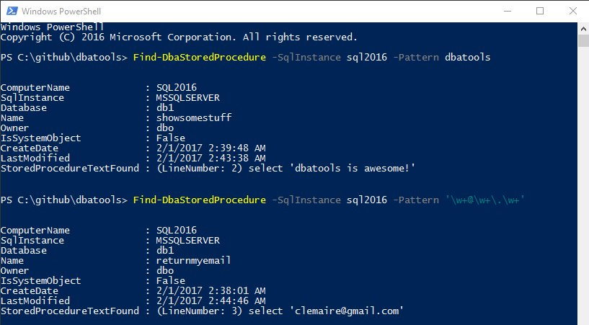
PowerShell ❤️ regex
Notes:
When you want the power of regex
More powerful and faster than LIKE
37,545 SQL Server stored procedures on 9 servers evaluated in 8.67 seconds!

Slide 37
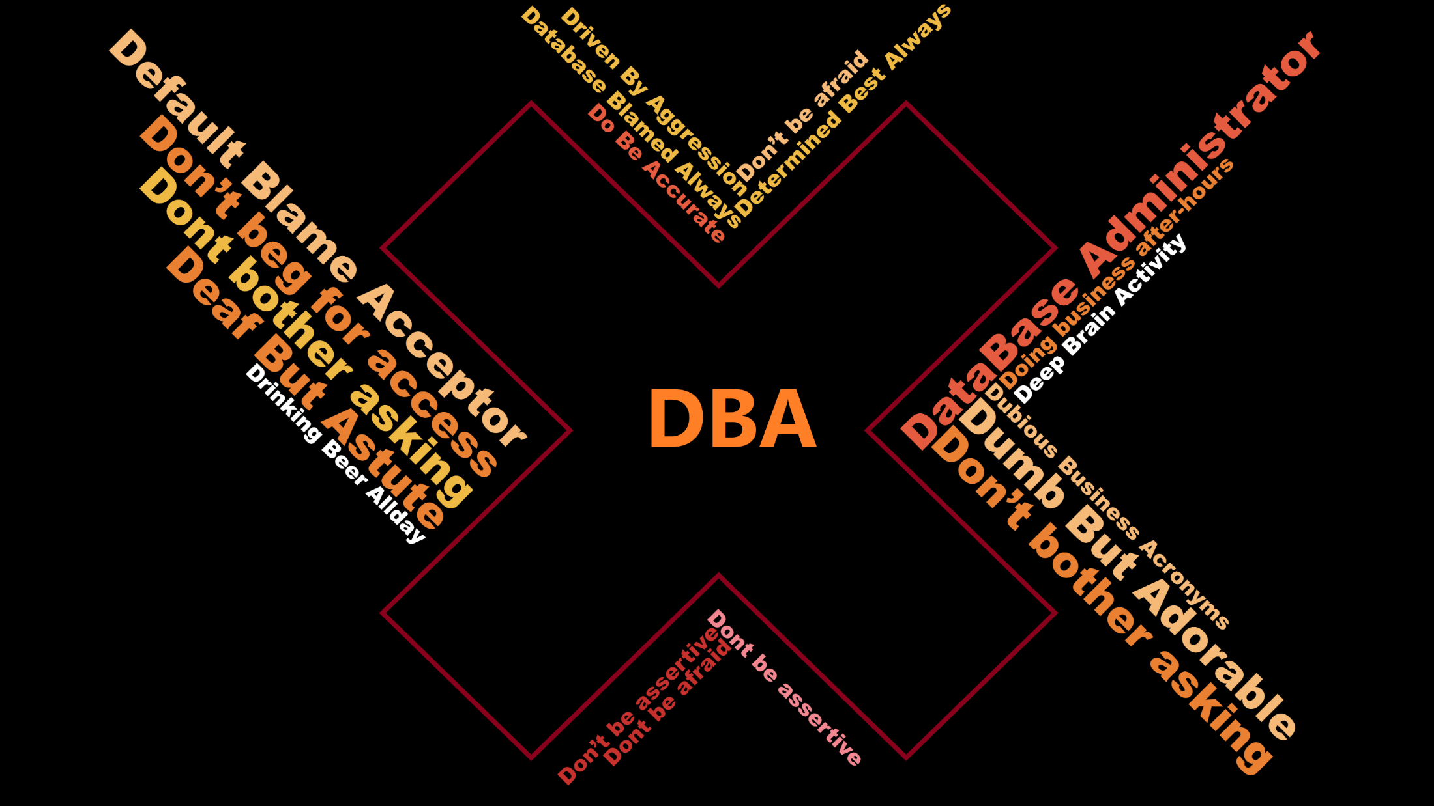

Slide 38
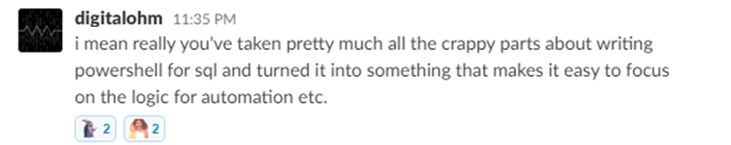
What is dbatools?

Slide 39

What is dbatools? – basically

Slide 40
What is dbatools? – actually
Photo by Kasya Shahovskaya on Unsplash

Slide 41

What is dbatools? – well basically
Notes:
We make it easy

Slide 42

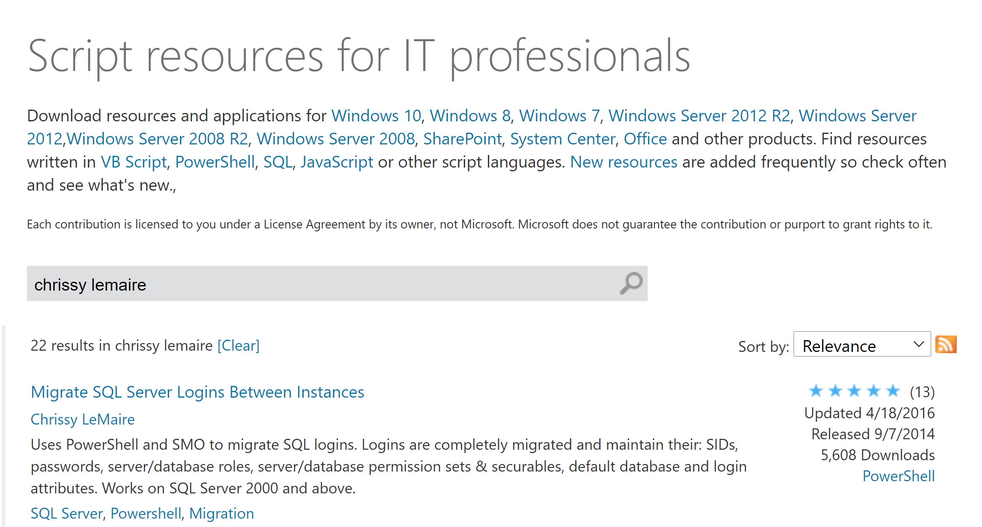
07/2014
Published to GitHub & ScriptCenter
07/2014
Need to Migrate Sharepoint databases
Microsoft Script Center

Slide 43
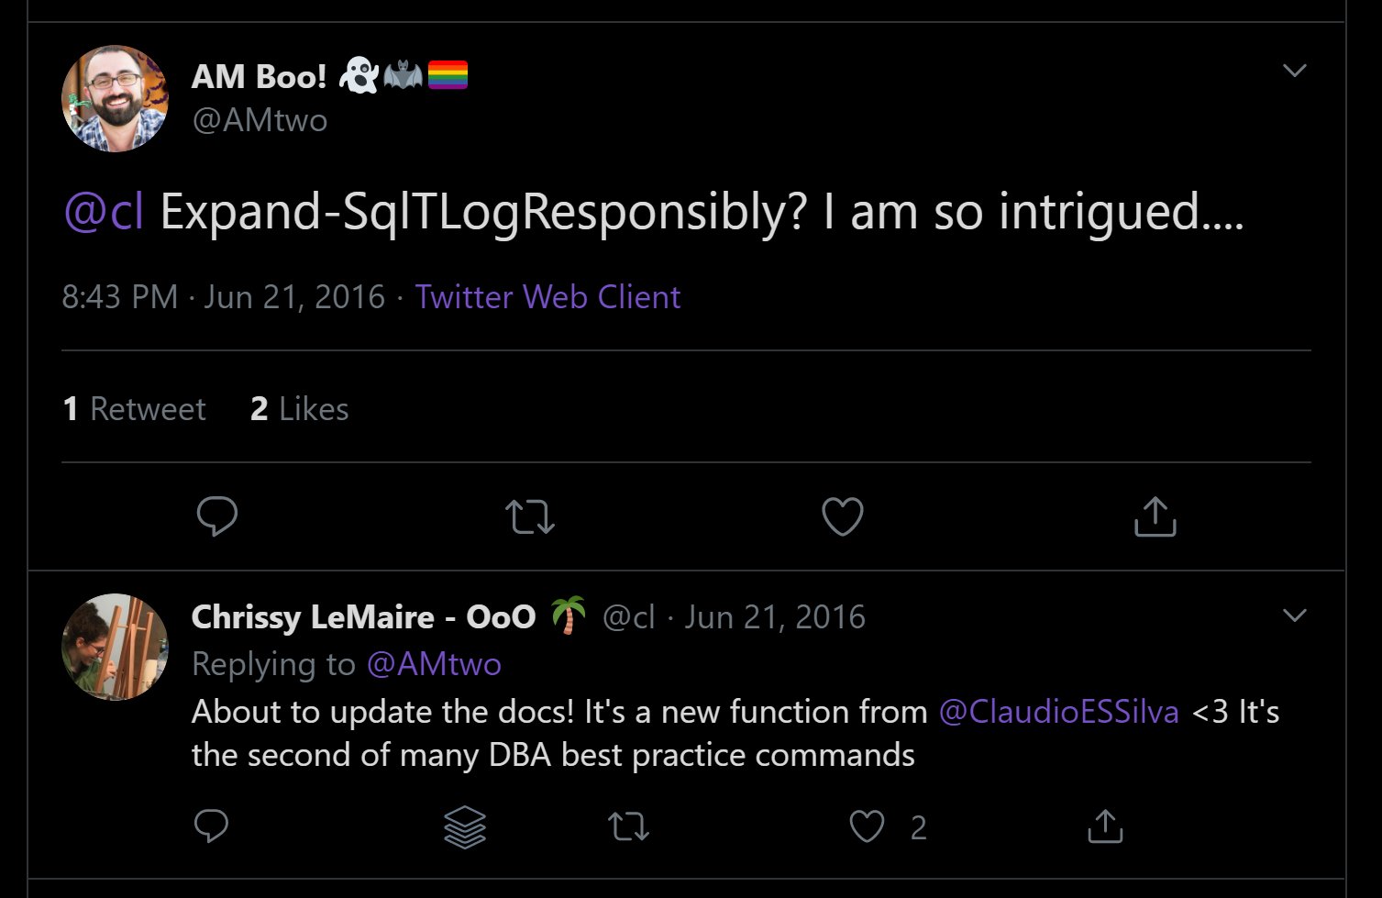
07/2014
Published to GitHub & ScriptCenter
07/2014
06/2016
Need to Migrate Sharepoint databases
First Community Contributions

Slide 44
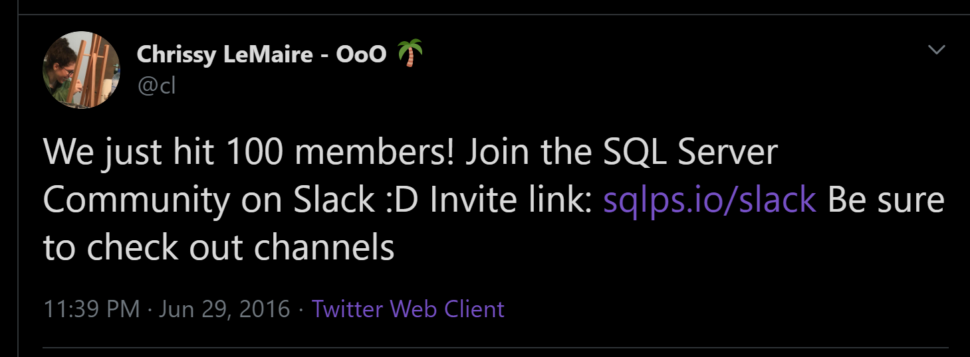
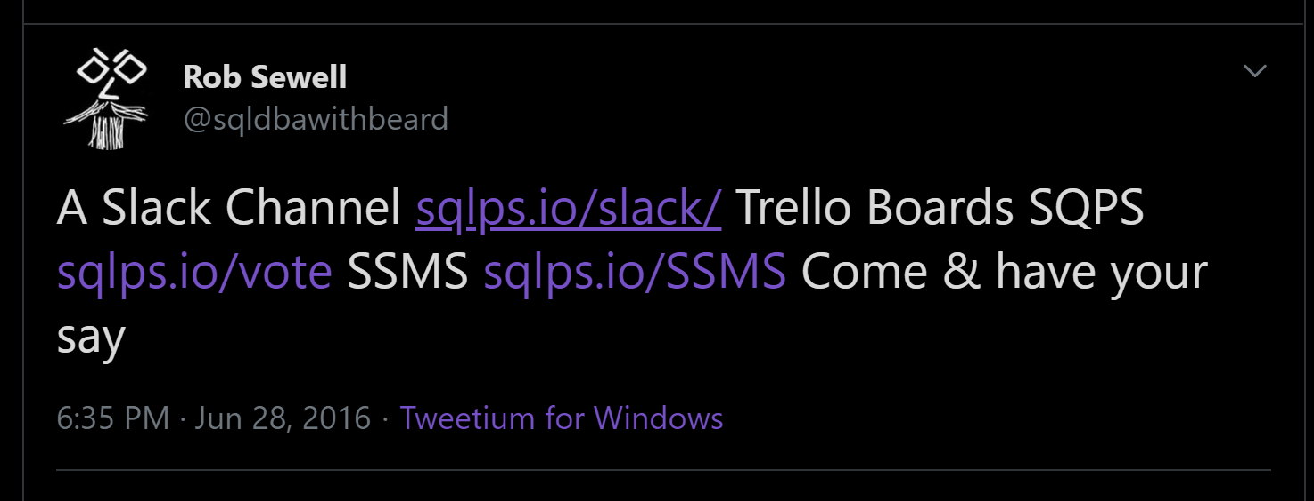
07/2014
06/2016
Published to GitHub & ScriptCenter
SQL Community Slack Was Born
07/2014
06/2016
Need to Migrate Sharepoint databases
First Community Contributions

Slide 45
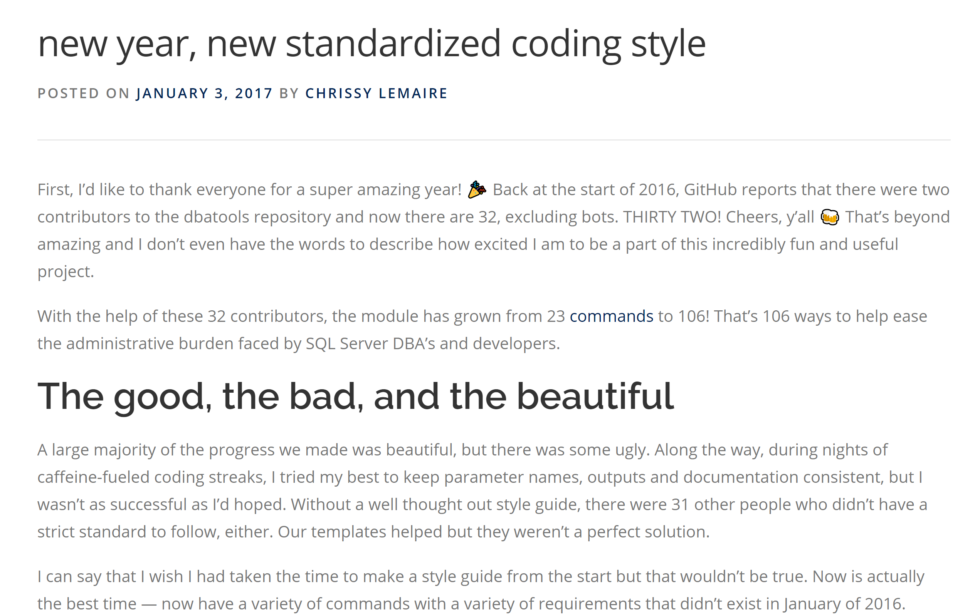
07/2014
06/2016
32 Contributors
Published to GitHub & ScriptCenter
SQL Community Slack Was Born
07/2014
06/2016
01/2017
Need to Migrate Sharepoint databases
First Community Contributions
The Road to 1.0 starts

Slide 47
07/2014
06/2016
32 Contributors
Published to GitHub & ScriptCenter
SQL Community Slack Was Born
07/2014
06/2016
01/2017
Need to Migrate Sharepoint databases
First Community Contributions
The Road to 1.0 starts

Slide 48

07/2014
06/2016
32 Contributors
Published to GitHub & ScriptCenter
03/2018
SQL Community Slack Was Born
MIT Licence
07/2014
06/2016
01/2017
Need to Migrate Sharepoint databases
First Community Contirbutions
The Road to 1.0 starts

Slide 49
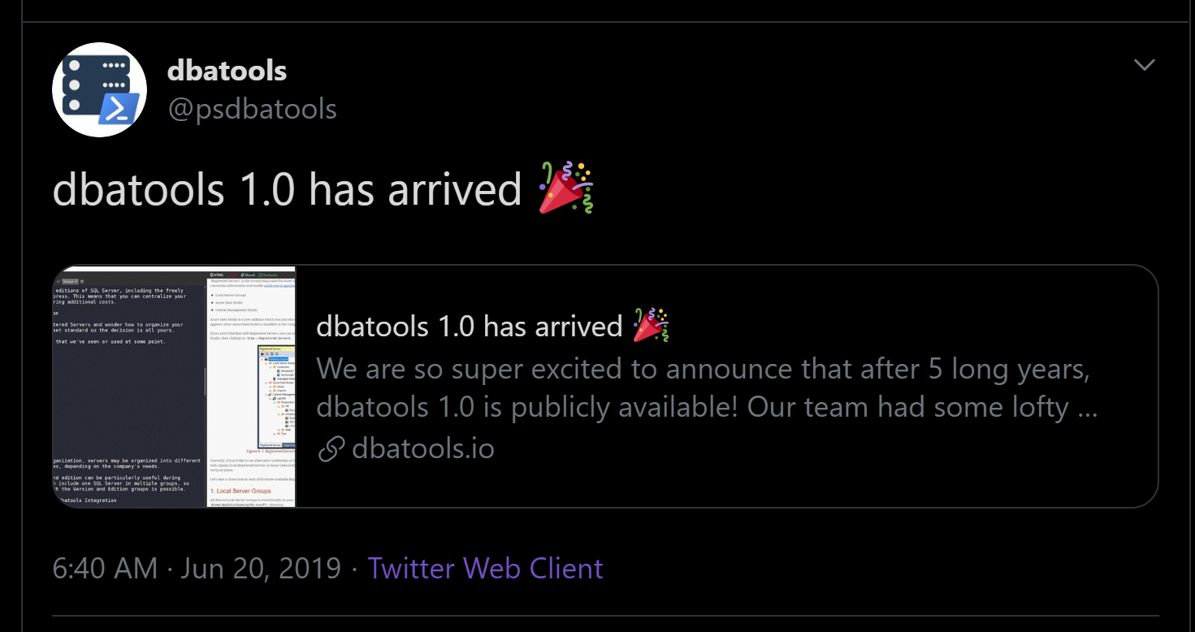
07/2014
06/2016
32 Contributors
Published to GitHub & ScriptCenter
03/2018
SQL Community Slack Was Born
MIT Licence
06/2016
01/2017
06/2019
07/2014
First Community Contirbutions
The Road to 1.0 starts
Dbatools 1.0
Need to Migrate Sharepoint databases

Slide 50
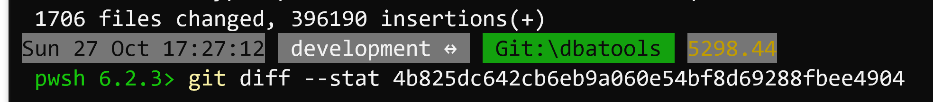
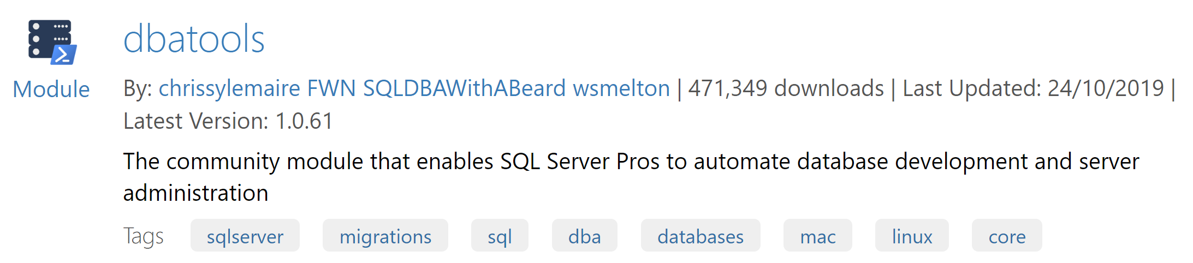


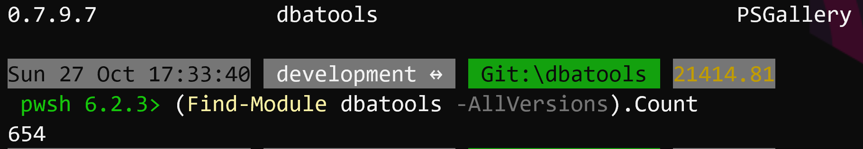
07/2014
06/2016
32 Contributors
Published to GitHub & ScriptCenter
03/2018
11/2019
SQL Community Slack Was Born
MIT Licence
06/2016
01/2017
06/2019
07/2014
First Community Contirbutions
The Road to 1.0 starts
Dbatools 1.0
Need to Migrate Sharepoint databases

Slide 51













































07/2014
06/2016
32 Contributors
Published to GitHub & ScriptCenter
SQL Community Slack Was Born
03/2018
11/2019
MIT Licence
07/2014
06/2016
01/2017
06/2019
Need to Migrate Sharepoint databases
First Community Contributions
The Road to 1.0 starts
Dbatools 1.0

Slide 52
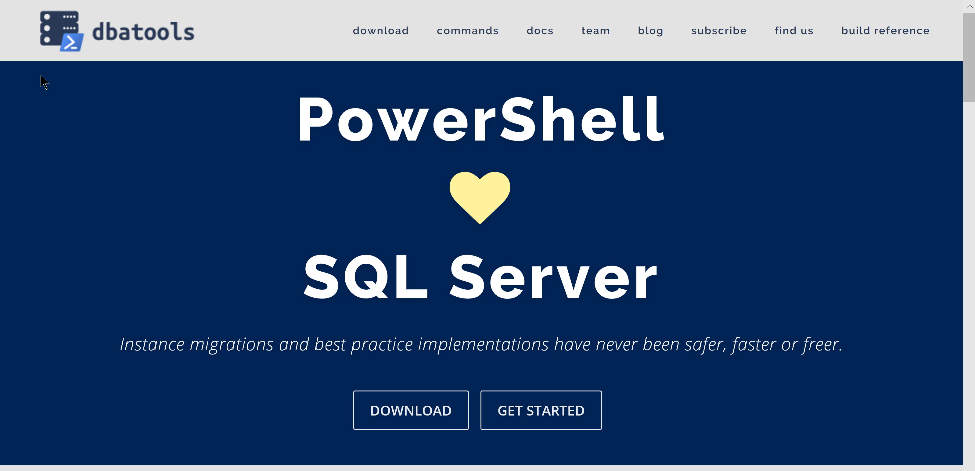
dbatools.io

Slide 53

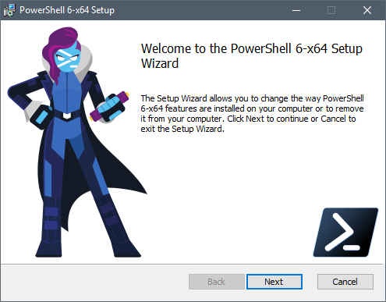
Client
PowerShell v5.1
Client
PowerShell v3
Better
Some functionality is not available
Also consider PowerShell Core pwsh
Cross Platform

Slide 54

Support
SQL Server 2000 – 2019 *
Express – Enterprise Edition
Clustered and stand-alone instances
Windows and SQL authentication
Default and named instances
Multiple instances on one server
What about Azure?
Notes:
* Azure

Slide 55
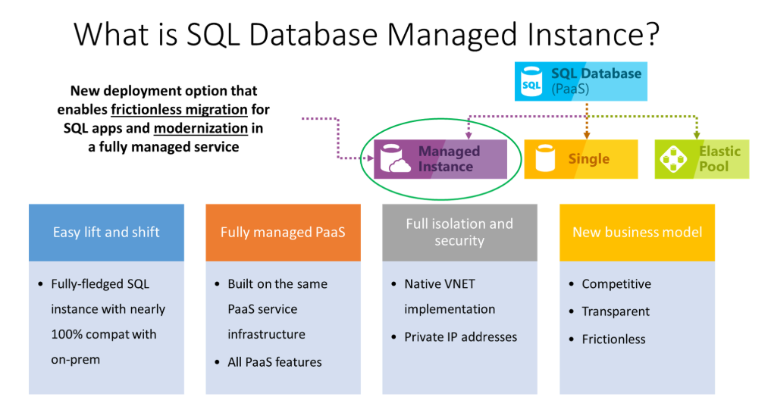
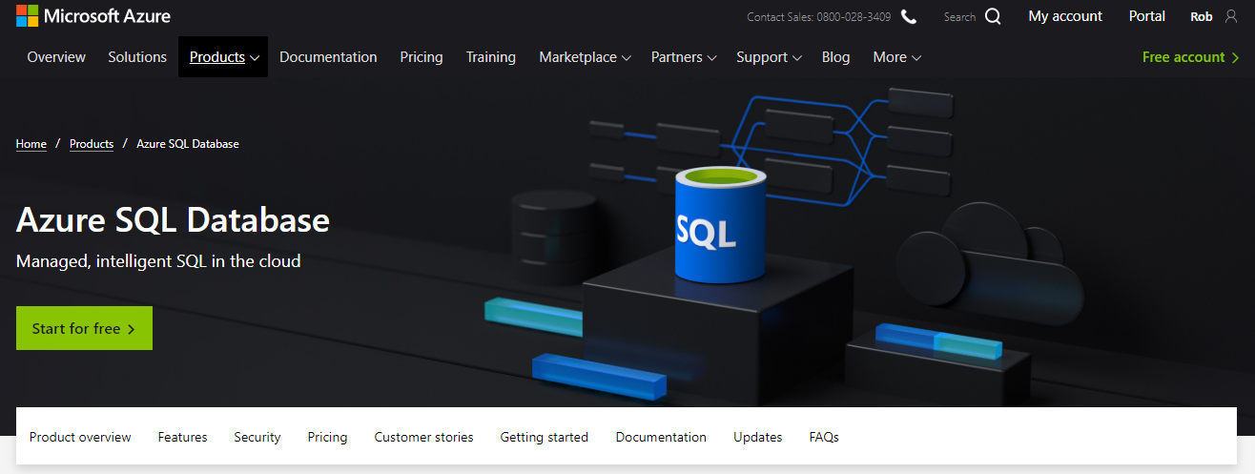
What about Azure?
Notes:
* Azure

Slide 56
PowerShell Remoting
Windows PowerShell supports remote computing by using various technologies, including WMI, SQL WMI, RPC, SSH & and WS-Management
Some commands require no remote configuration, including
Restart-Computer
Test-Connection
Get-HotFix
Get-Process
Get-Service
Get-WinEvent
Get-WmiObject
“Remoting” refers to commands that use WS-Management
Notes:
https://docs.microsoft.com/en-us/powershell/scripting/core-powershell/running-remote-commands?view=powershell-5.1

Slide 57
PowerShell Remoting (WS-Management)
Microsoft’s recommended way to manage Windows
By default, only allows connections from members of the Administrators group
Single port 5985 or 5986
Uses the Web Services for Management (WS-Management) protocol
Regardless of the transport protocol used (HTTP or HTTPS), PowerShell Remoting always encrypts all communication after initial authentication with a per-session AES-256 symmetric key
Initial authentication is NTLM, Kerberos and Certificates so no credentials are ever exposed
Notes:
https://docs.microsoft.com/en-us/powershell/scripting/setup/winrmsecurity?view=powershell-5.1
https://blogs.technet.microsoft.com/ashleymcglone/2016/06/29/whos-afraid-of-powershell-security
https://github.com/psconfeu/2017/tree/master/David%20das%20Neves/PSConfEU17_Security_Preconf
https://blogs.msdn.microsoft.com/daviddasneves/2017/05/25/powershell-security-at-enterprise-customers/
https://vimeo.com/17649459

Slide 58
PowerShell Security In-Depth
sqlps.io/owned
Notes:
See a dude own a DC thru jpg, sql server and a stolen token

Slide 59
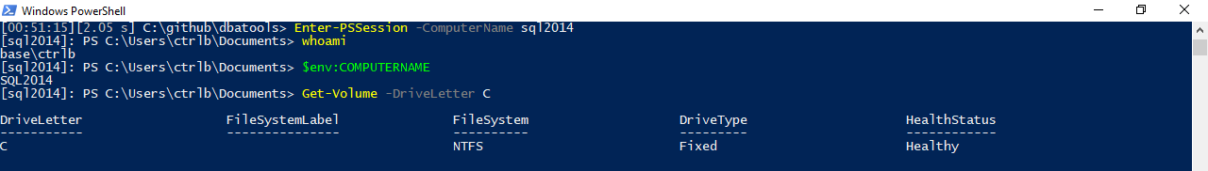
PowerShell Remoting
Notes:
Windows PowerShell supports remote computing by using various technologies, including WMI, RPC, and WS-Management.

Slide 60
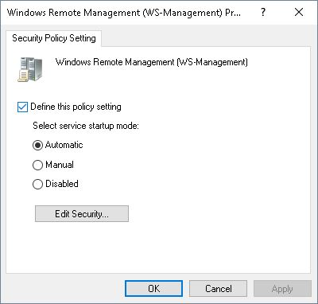
PowerShell Remoting
Enable-PSRemoting
winrm quickconfig
Via Group Policy Objects
Notes:
https://4sysops.com/archives/enable-powershell-remoting/

Slide 61
Remoting Setup
sqlps.io/remoting
Notes:
See a dude own a DC thru jpg, sql server and a stolen token

Slide 62
PowerShell Remoting
Windows PowerShell supports remote computing by using various technologies, including WMI, SQL WMI, RPC, SSH & and WS-Management
Some commands require no remote configuration, including
Restart-Computer
Test-Connection
Get-HotFix
Get-Process
Get-Service
Get-WinEvent
Get-WmiObject
“Remoting” refers to commands that use WS-Management
Notes:
https://docs.microsoft.com/en-us/powershell/scripting/core-powershell/running-remote-commands?view=powershell-5.1

Slide 63
PowerShell Remoting (WS-Management)
Microsoft’s recommended way to manage Windows
By default, only allows connections from members of the Administrators group
Single port 5985 or 5986
Uses the Web Services for Management (WS-Management) protocol
Regardless of the transport protocol used (HTTP or HTTPS), PowerShell Remoting always encrypts all communication after initial authentication with a per-session AES-256 symmetric key
Initial authentication is NTLM, Kerberos and Certificates so no credentials are ever exposed
Notes:
https://docs.microsoft.com/en-us/powershell/scripting/setup/winrmsecurity?view=powershell-5.1
https://blogs.technet.microsoft.com/ashleymcglone/2016/06/29/whos-afraid-of-powershell-security
https://github.com/psconfeu/2017/tree/master/David%20das%20Neves/PSConfEU17_Security_Preconf
https://blogs.msdn.microsoft.com/daviddasneves/2017/05/25/powershell-security-at-enterprise-customers/
https://vimeo.com/17649459

Slide 64
PowerShell Security In-Depth
sqlps.io/owned
Notes:
See a dude own a DC thru jpg, sql server and a stolen token

Slide 65
PowerShell Remoting
Notes:
Windows PowerShell supports remote computing by using various technologies, including WMI, RPC, and WS-Management.

Slide 66
PowerShell Remoting
Enable-PSRemoting
winrm quickconfig
Via Group Policy Objects
Notes:
https://4sysops.com/archives/enable-powershell-remoting/

Slide 67
Remoting Setup
sqlps.io/remoting
Notes:
See a dude own a DC thru jpg, sql server and a stolen token

Slide 68


PowerShell Security

Slide 69
PowerShell Security
“Secure by Design”

Slide 70
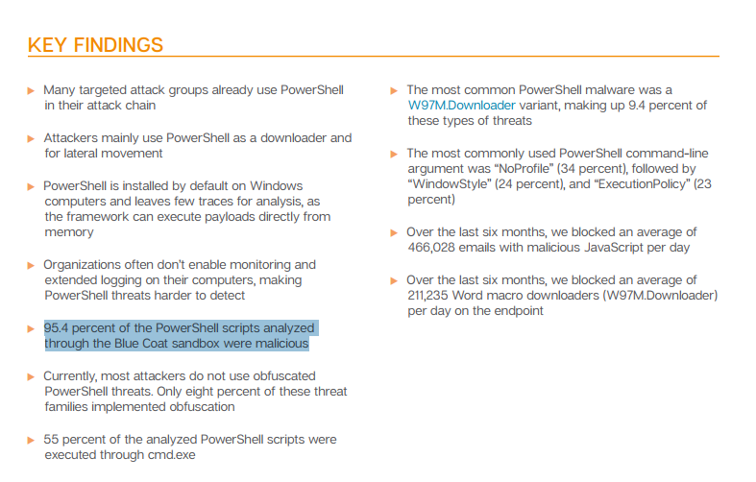
FUD in the Media
🙄
Notes:
https://www.symantec.com/connect/blogs/powershell-threats-surge-954-percent-analyzed-scripts-were-malicious

Slide 71
FUD in the Media
“AV, they love to talk about ransomeware attacks that use PowerShell, and the reason they do this is because they literally can’t keep up with the plain old stuff like exes. But they also do this because we as a community encourage it. We blog it, we tweet about it, we talk about it. And the next thing you hear is that there’s a PowerShell problem. They don’t seem to ask how to solve their C++ problem or their darn x64 problem.” ~ Lee Holmes, DerbyCon 2016 Keynote
Notes:
https://www.youtube.com/watch?v=BMreZZ1cgFI
https://docs.microsoft.com/en-us/powershell/scripting/setup/winrmsecurity?view=powershell-5.1
https://blogs.technet.microsoft.com/ashleymcglone/2016/06/29/whos-afraid-of-powershell-security
https://github.com/psconfeu/2017/tree/master/David%20das%20Neves/PSConfEU17_Security_Preconf
https://blogs.msdn.microsoft.com/daviddasneves/2017/05/25/powershell-security-at-enterprise-customers/

Slide 72
Context
”When security researchers leverage PowerShell, it is always in a post-compromise context. They have compromised a machine through some other avenue (phishing, SQL injection, etc.), and ultimately have the choice of any number of tools on the system. They were able to accomplish their goals before PowerShell, and will be able to accomplish their goals without PowerShell.”
~ Lee Holmes, Principal Security Architect
Notes:
https://blogs.msdn.microsoft.com/powershell/2016/09/27/powershell-security-at-derbycon/

Slide 73
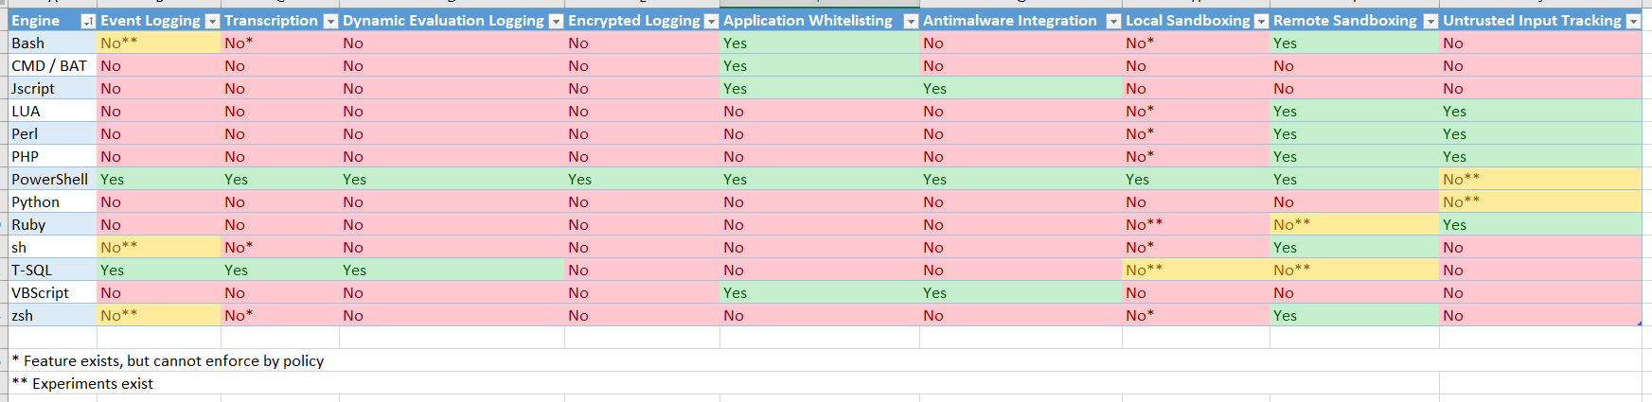
Logging
Notes:
https://blogs.msdn.microsoft.com/powershell/2017/04/10/a-comparison-of-shell-and-scripting-language-security/
Event Logging – The engine logs audit events of important operational events.
Transcription – The engine logs application inputs and outputs.
Dynamic Evaluation Logging – The engine logs the content of all content evaluation, including those generated or composed at runtime.
Application Whitelisting – The engine allows enforcement of code integrity / application whitelisting policies, including user-authored documents / scripts.
Antimalware Integration – The engine actively integrates with antimalware software to evaluate the safety of code generated at runtime.
Local Sandboxing – The engine allows sandboxing of behavior for local and interactive use.
Remote Sandboxing – The engine allows sandboxing of behavior when accessed remotely.
Untrusted Input Tracking – The engine allows script developers to track and make security decisions based on whether a variable or input was influenced by user input.

Slide 74
PowerShell Security In-Depth
sqlps.io/secure
Notes:
“The security argument for PowerShell is not that it's impenetrable, but that the API is designed with security in mind, and the PowerShell team itself has an impressive turnaround time when it comes to mitigating vulnerabilities. Ultimately, a quick and measured response is better than believing in total security.”
~ Mathias Jessen, @iisresetme

Slide 75

SQL Server
Pester
❤️

Slide 76
TODAY’s TO DO LIST
GET UP
Drink Appropriate Liquid
The Rest

Slide 77
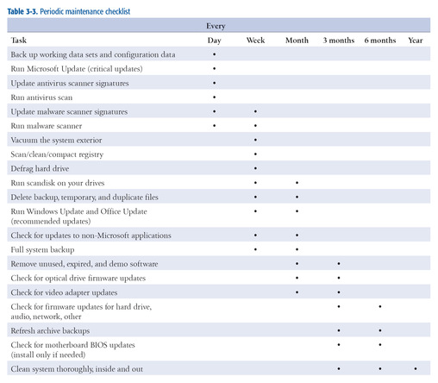
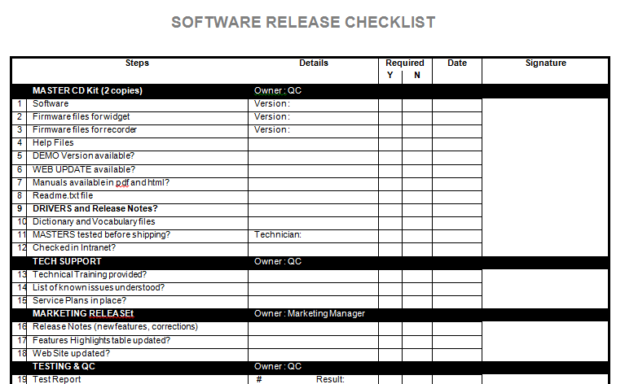
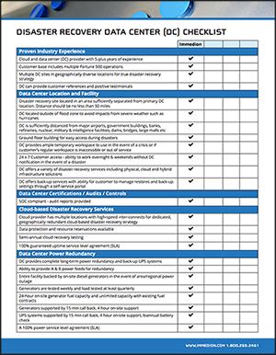
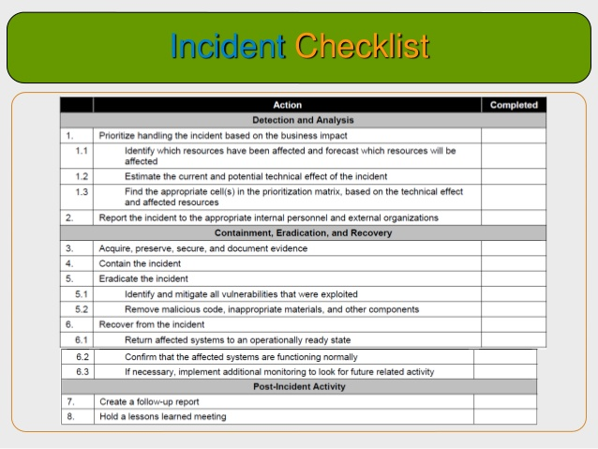
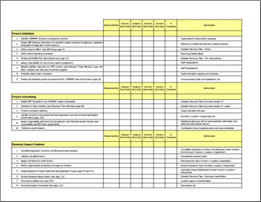
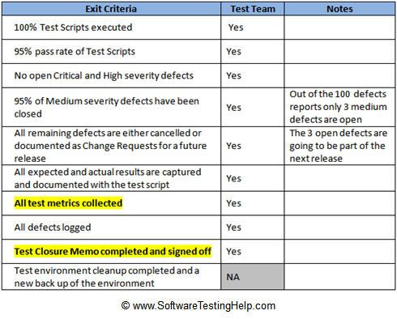
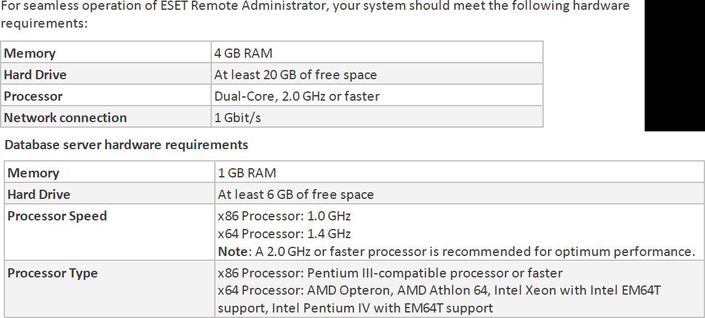
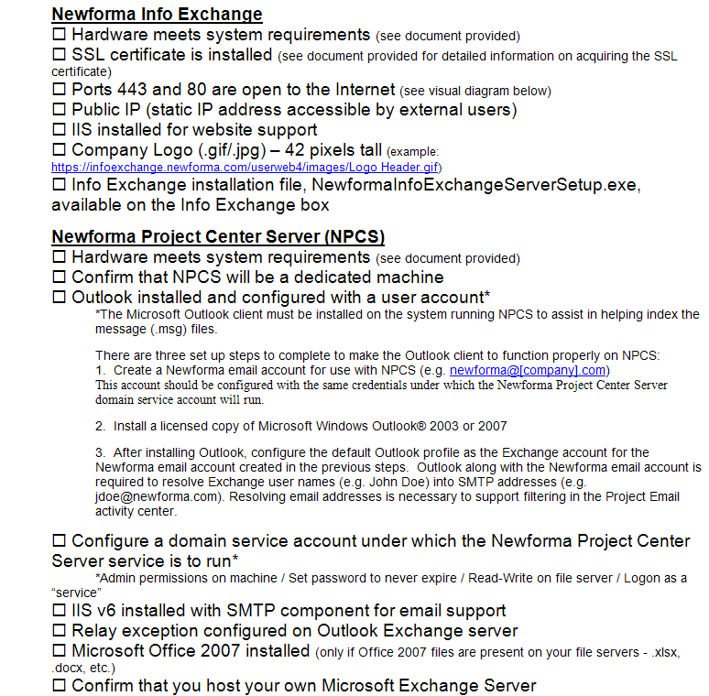
How many checklists do you have?
Notes:
I bet there are checklists for
New servers/ data centers
Hardware/software installations
Incident Response
1st Line/2nd line for systems
Pre-requisites
Morning routines

Slide 78
What about
Demos
Presentations
Morning Checks
Incident Response
First Line Support
I‘m sure you are already thinking of more

Slide 79
What is Pester?
Pester provides a framework for running unit tests to execute and validate PowerShell commands from within PowerShell
sqlps.io/pester
Notes:
Its used for unit testing or TDD but can also be used to validate an environment.
Comes with Windows 10 or install from the gallery with Install-Module Pester

Slide 80
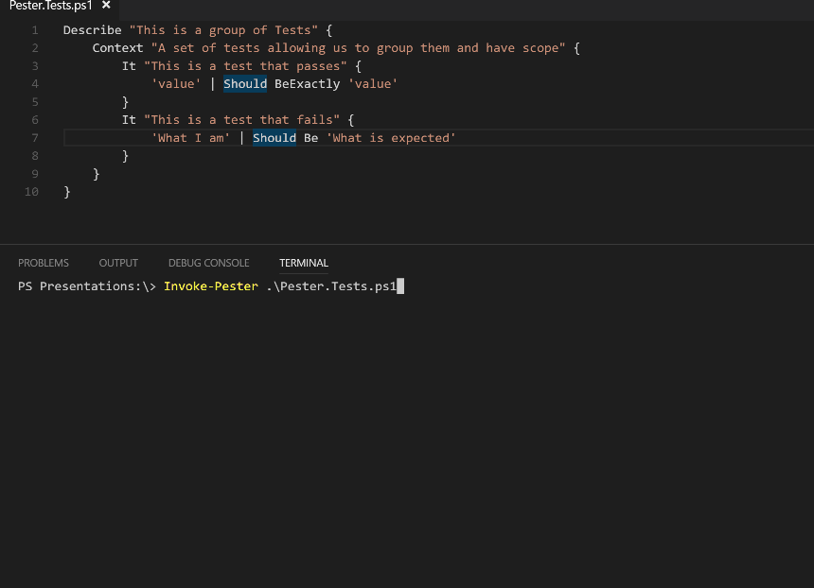
What Does Pester Look Like?
Notes:
This is a Pester test running in VS Code

Slide 81

Apologies. Forgive Me!

Slide 82
Should Operators
Be Compares one object with another for equality. Case Insensitive BeExactly Compares one object with another for equality. Case Sensitive BeGreaterThan Asserts that a number is greater than an expected value. BeLessThan Asserts that a number is less than an expected value. BeLike Asserts that the actual value matches a wildcard pattern using -like operator. Case Insensitive BeLikeExactly Asserts that the actual value matches a wildcard pattern using -like operator. Case Sensitive BeOfType Asserts that the actual value should be an object of a specified type Exist Does not perform any comparison but checks if the object calling Exist is present in a PS Provider. Contain Checks to see if a file contains the specified text. Case Insensitive ContainExactly Checks to see if a file contains the specified text. Case Sensitive Match Uses a regular expression to compare two objects. Case Insensitive MatchExactly Uses a regular expression to compare two objects. Case Sensitive Throw Checks if an exception was thrown in the input ScriptBlock. BeNullOrEmpty Checks values for null or empty (strings).
I hate slides with lots of text but I think this one is valid
Notes:
For you to use in the future – The important one to remember is the contains

Slide 83

So what can you validate ?
Notes:
Everything in the world ☺

Slide 84
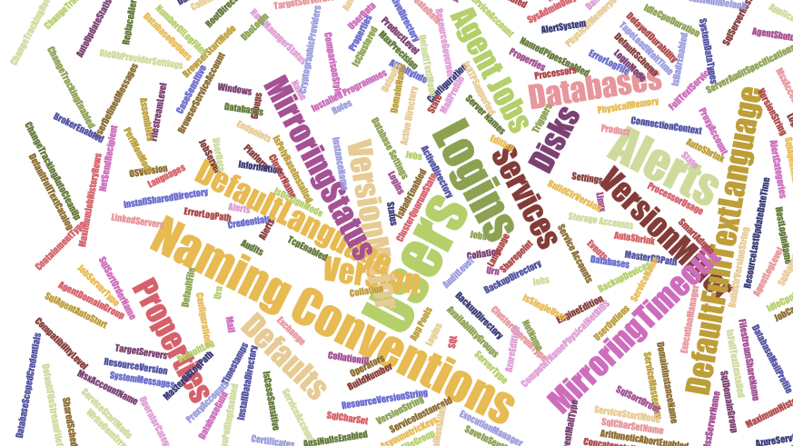
Maybe not EVERYthing!
but anything you can validate with PowerShell
Notes:
These are just some of the properties of
A SQL Server SMO object,
A Job Server object and
A database object
There are (for SQL Server 2017
113 properties on a SQL Server Instance object
75 on a Configuration object
184 properties ona Database object
47 on a Job Server object
40 on a Job Object
AND That’s just SQL Server – Files, Operating System, Active Directory etc etc etc

Slide 85
Maybe not EVERYTHING – Part 2
Which Does NOT include
Describe “Bag Packing” {
Context “Hardware”{
It “Bag Should include BeardNUC” {
$bag.Contents –contains ‘beardnuc’| Should Be $True
}
}
}
I had no virtual machines with me Queue demo re-write until 3am!
Notes:
Whilst this is a funny slide there is an important piece of Pester knowledge here
This is the correct way to test if an array contains a value

Slide 86

Hey Beardy!
DEMO
Time

Slide 87
Summary
We all have checklists – manual testing is error-prone
Pester is a Unit Testing Framework for PowerShell
You can use it to validate your infrastructure
The basic syntax - Describe, Context and It code blocks
The Should command is used for testing assertions
Use the NunitXML output, export to JSON and use PowerBi for fantastic reports or to be consumed in your CI/CD process

Slide 88

Before Lunch
If you didn’t meet the pre-reqs, please enter your email at sqlps.io/signup for Azure access to a lab
Somewhat limited number. First msg’d, first served

Slide 89

Lunch

Slide 90
Enjoyed Lunch?
If you need help with any setup ask a proctor or in the dedicated Slack channel
sqlps.io/azurelab
Notes:
FileSystem::\\UNC

Slide 91
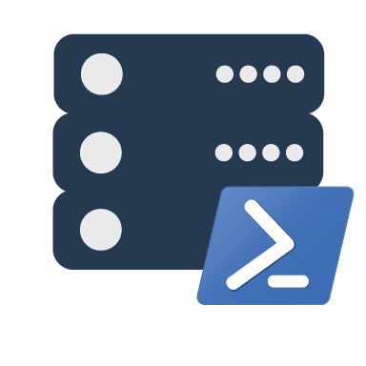
dbatools
the community module
Notes:
Intro to dbatools

Slide 92
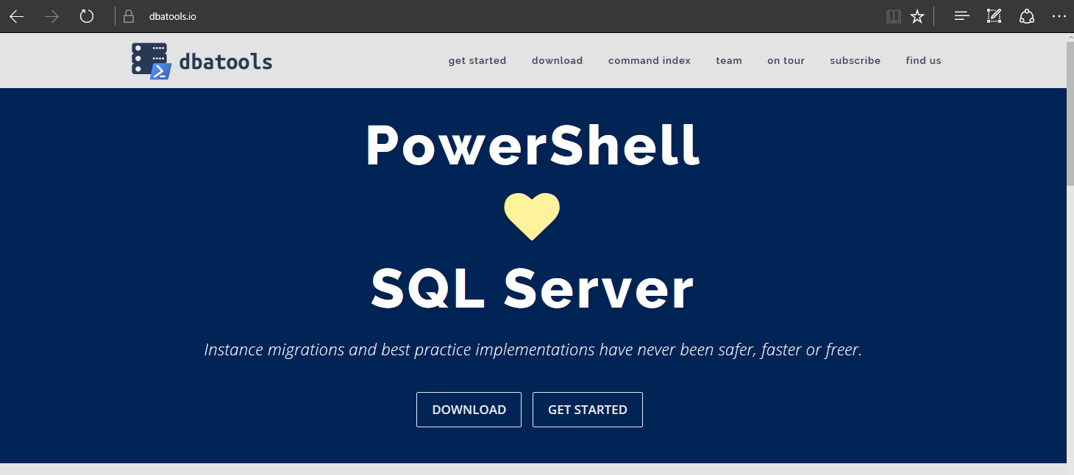
dbatools

Slide 93
Basically..

Slide 94
Support
SQL Server 2000 – vNext
Express – Enterprise Edition
Clustered and stand-alone instances
Windows and SQL authentication
Default and named instances
Multiple instances on one server

Slide 95
System Requirements
MINIMUM
RECOMMENDED
Client
PowerShell v3
Server
SQL Server 2000
No PowerShell for pure SQL commands
PowerShell v2 for Windows commands
Remote PowerShell enabled for Windows commands
Client
PowerShell v5.1
Server
SQL Server 2008 R2+
Notes:
SQL Server 2000 – think “Can SSMS connect?”

Slide 96
Install is easy
POWERSHELL GALLERY
Install-Module dbatools
Install-Module dbatools –Scope CurrentUser
GITHUB
Invoke-Expression (Invoke-WebRequest dbatools.io/in)
WEBSITE
dbatools.io/download

Slide 97
Need an offline install?
GET THE ZIP
dbatools.io/zip
INSTALL TO YOUR $env:PSMODULEPATH
By default at
$home\Documents\WindowsPowerShell\Modules
$env:SystemDrive\Program Files\WindowsPowerShell\Modules

Slide 98
Need an offline install?
dbatools.io/offline

Slide 99
Now, to Import
After installing, you must import the module
Import-Module dbatools
Module manifest vs. Script module
psd1 – module manifest
formal, explicit
psm1
more informal, all functions are imported
Notes:
Speaking of functions!

Slide 100

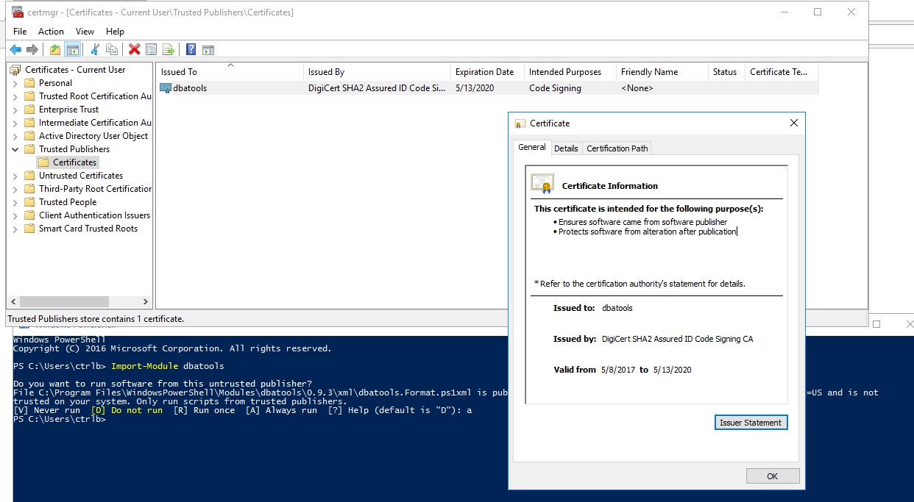
dbatools is digitally signed

Slide 101
Set-ExecutionPolicy
“Execution Policy is not a security control and should not be treated as one. The security control is Application Whitelisting (AppLocker / Device Guard)” ~ PowerShell Team
“It's important to understand that the setting was never meant to be a security control. Instead, it was intended to prevent administrators from shooting themselves in the foot.” ~ Scott Sutherland, author of PowerUpSQL
Notes:
https://blog.netspi.com/15-ways-to-bypass-the-powershell-execution-policy
https://www.darkoperator.com/blog/2013/3/5/powershell-basics-execution-policy-part-1.html
https://blogs.msdn.microsoft.com/powershell/2008/09/30/powershells-security-guiding-principles/
“ExecutionPolicy is like a baby door. The ExecutionPolicy keeps babies safe but every grown-up passes it easily.” ~ David das Neves, Microsoft PFE

Slide 102
For more information
dbatools.io/fullinstall

Slide 103
How to Get-Help
Extensive documentation within each command
Get-Help Start-DbaMigration -Detailed
Extensive documentation on dbatools.io
dbatools.io/Test-DbaLastBackup dbatools.io/Set-DbaSpn
Some commands have videos
dbatools.io/youtube

Slide 104
dbatools vs SqlServer
SqlServer is officially supported by Microsoft
SqlServer is C# cmdlet based
SqlServer is closed-source & must be fixed and enhanced by Microsoft
SqlServer has fewer resources
dbatools has unofficial, community-based support
dbatools is PowerShell function based
dbatools is open source – fix or enhance yourself or ask us
dbatools has 80+ contributors

Slide 105
PowerShell Remoting
Windows PowerShell supports remote computing by using various technologies, including WMI, SQL WMI, RPC, SSH & and WS-Management
Some commands require no remote configuration, including
Restart-Computer
Test-Connection
Get-HotFix
Get-Process
Get-Service
Get-WinEvent
Get-WmiObject
“Remoting” refers to commands that use WS-Management
Notes:
https://docs.microsoft.com/en-us/powershell/scripting/core-powershell/running-remote-commands?view=powershell-5.1

Slide 106
PowerShell Remoting (WS-Management)
Microsoft’s recommended way to manage Windows
By default, only allows connections from members of the Administrators group
Single port 5985 or 5986
Uses the Web Services for Management (WS-Management) protocol
Regardless of the transport protocol used (HTTP or HTTPS), PowerShell Remoting always encrypts all communication after initial authentication with a per-session AES-256 symmetric key
Initial authentication is NTLM, Kerberos and Certificates so no credentials are ever exposed
Notes:
https://docs.microsoft.com/en-us/powershell/scripting/setup/winrmsecurity?view=powershell-5.1
https://blogs.technet.microsoft.com/ashleymcglone/2016/06/29/whos-afraid-of-powershell-security
https://github.com/psconfeu/2017/tree/master/David%20das%20Neves/PSConfEU17_Security_Preconf
https://blogs.msdn.microsoft.com/daviddasneves/2017/05/25/powershell-security-at-enterprise-customers/
https://vimeo.com/17649459

Slide 107
PowerShell Security In-Depth
sqlps.io/owned
Notes:
See a dude own a DC thru jpg, sql server and a stolen token

Slide 108
PowerShell Remoting
Notes:
Windows PowerShell supports remote computing by using various technologies, including WMI, RPC, and WS-Management.

Slide 109
PowerShell Remoting
Enable-PSRemoting
winrm quickconfig
Via Group Policy Objects
Notes:
https://4sysops.com/archives/enable-powershell-remoting/

Slide 110
Remoting Setup
sqlps.io/remoting
Notes:
See a dude own a DC thru jpg, sql server and a stolen token

Slide 111
PowerShell Security

Slide 112
PowerShell Security
“Secure by Design”

Slide 113
FUD in the Media
🙄
Notes:
https://www.symantec.com/connect/blogs/powershell-threats-surge-954-percent-analyzed-scripts-were-malicious

Slide 114
FUD in the Media
“AV, they love to talk about ransomeware attacks that use PowerShell, and the reason they do this is because they literally can’t keep up with the plain old stuff like exes. But they also do this because we as a community encourage it. We blog it, we tweet about it, we talk about it. And the next thing you hear is that there’s a PowerShell problem. They don’t seem to ask how to solve their C++ problem or their darn x64 problem.” ~ Lee Holmes, DerbyCon 2016 Keynote
Notes:
https://www.youtube.com/watch?v=BMreZZ1cgFI
https://docs.microsoft.com/en-us/powershell/scripting/setup/winrmsecurity?view=powershell-5.1
https://blogs.technet.microsoft.com/ashleymcglone/2016/06/29/whos-afraid-of-powershell-security
https://github.com/psconfeu/2017/tree/master/David%20das%20Neves/PSConfEU17_Security_Preconf
https://blogs.msdn.microsoft.com/daviddasneves/2017/05/25/powershell-security-at-enterprise-customers/

Slide 115
Context
”When security researchers leverage PowerShell, it is always in a post-compromise context. They have compromised a machine through some other avenue (phishing, SQL injection, etc.), and ultimately have the choice of any number of tools on the system. They were able to accomplish their goals before PowerShell, and will be able to accomplish their goals without PowerShell.”
~ Lee Holmes, Principal Security Architect
Notes:
https://blogs.msdn.microsoft.com/powershell/2016/09/27/powershell-security-at-derbycon/

Slide 116
Logging
Notes:
https://blogs.msdn.microsoft.com/powershell/2017/04/10/a-comparison-of-shell-and-scripting-language-security/
Event Logging – The engine logs audit events of important operational events.
Transcription – The engine logs application inputs and outputs.
Dynamic Evaluation Logging – The engine logs the content of all content evaluation, including those generated or composed at runtime.
Application Whitelisting – The engine allows enforcement of code integrity / application whitelisting policies, including user-authored documents / scripts.
Antimalware Integration – The engine actively integrates with antimalware software to evaluate the safety of code generated at runtime.
Local Sandboxing – The engine allows sandboxing of behavior for local and interactive use.
Remote Sandboxing – The engine allows sandboxing of behavior when accessed remotely.
Untrusted Input Tracking – The engine allows script developers to track and make security decisions based on whether a variable or input was influenced by user input.

Slide 117
PowerShell Security In-Depth
sqlps.io/secure
Notes:
“The security argument for PowerShell is not that it's impenetrable, but that the API is designed with security in mind, and the PowerShell team itself has an impressive turnaround time when it comes to mitigating vulnerabilities. Ultimately, a quick and measured response is better than believing in total security.”
~ Mathias Jessen, @iisresetme

Slide 118
SQL Server
Pester
❤️

Slide 119
TODAY’s TO DO LIST
GET UP
Drink Appropriate Liquid
The Rest

Slide 120
How many checklists do you have?
Notes:
I bet there are checklists for
New servers/ data centers
Hardware/software installations
Incident Response
1st Line/2nd line for systems
Pre-requisites
Morning routines

Slide 121
What about
Demos
Presentations
Morning Checks
Incident Response
First Line Support
I‘m sure you are already thinking of more

Slide 122
What is Pester?
Pester provides a framework for running unit tests to execute and validate PowerShell commands from within PowerShell
sqlps.io/pester
Notes:
Its used for unit testing or TDD but can also be used to validate an environment.
Comes with Windows 10 or install from the gallery with Install-Module Pester

Slide 123
What Does Pester Look Like?
Notes:
This is a Pester test running in VS Code

Slide 124
Apologies. Forgive Me!

Slide 125
Should Operators
Be Compares one object with another for equality. Case Insensitive BeExactly Compares one object with another for equality. Case Sensitive BeGreaterThan Asserts that a number is greater than an expected value. BeLessThan Asserts that a number is less than an expected value. BeLike Asserts that the actual value matches a wildcard pattern using -like operator. Case Insensitive BeLikeExactly Asserts that the actual value matches a wildcard pattern using -like operator. Case Sensitive BeOfType Asserts that the actual value should be an object of a specified type Exist Does not perform any comparison but checks if the object calling Exist is present in a PS Provider. Contain Checks to see if a file contains the specified text. Case Insensitive ContainExactly Checks to see if a file contains the specified text. Case Sensitive Match Uses a regular expression to compare two objects. Case Insensitive MatchExactly Uses a regular expression to compare two objects. Case Sensitive Throw Checks if an exception was thrown in the input ScriptBlock. BeNullOrEmpty Checks values for null or empty (strings).
I hate slides with lots of text but I think this one is valid
Notes:
For you to use in the future – The important one to remember is the contains

Slide 126
So what can you validate ?
Notes:
Everything in the world ☺

Slide 127
Maybe not EVERYthing!
but anything you can validate with PowerShell
Notes:
These are just some of the properties of
A SQL Server SMO object,
A Job Server object and
A database object
There are (for SQL Server 2017
113 properties on a SQL Server Instance object
75 on a Configuration object
184 properties ona Database object
47 on a Job Server object
40 on a Job Object
AND That’s just SQL Server – Files, Operating System, Active Directory etc etc etc

Slide 128
Maybe not EVERYTHING – Part 2
Which Does NOT include
Describe “Bag Packing” {
Context “Hardware”{
It “Bag Should include BeardNUC” {
$bag.Contents –contains ‘beardnuc’| Should Be $True
}
}
}
I had no virtual machines with me Queue demo re-write until 3am!
Notes:
Whilst this is a funny slide there is an important piece of Pester knowledge here
This is the correct way to test if an array contains a value

Slide 129
Hey Beardy!
DEMO
Time

Slide 130
Summary
We all have checklists – manual testing is error-prone
Pester is a Unit Testing Framework for PowerShell
You can use it to validate your infrastructure
The basic syntax - Describe, Context and It code blocks
The Should command is used for testing assertions
Use the NunitXML output, export to JSON and use PowerBi for fantastic reports or to be consumed in your CI/CD process

Slide 131
Before Lunch
If you didn’t meet the pre-reqs, please enter your email at sqlps.io/signup for Azure access to a lab
Somewhat limited number. First msg’d, first served

Slide 132
Lunch

Slide 133
Enjoyed Lunch?
If you need help with any setup ask a proctor or in the dedicated Slack channel
sqlps.io/azurelab
Notes:
FileSystem::\\UNC

Slide 134
dbatools
the community module
Notes:
Intro to dbatools

Slide 135
dbatools

Slide 136
Basically..

Slide 137
Support
SQL Server 2000 – vNext
Express – Enterprise Edition
Clustered and stand-alone instances
Windows and SQL authentication
Default and named instances
Multiple instances on one server

Slide 138
System Requirements
MINIMUM
RECOMMENDED
Client
PowerShell v3
Server
SQL Server 2000
No PowerShell for pure SQL commands
PowerShell v2 for Windows commands
Remote PowerShell enabled for Windows commands
Client
PowerShell v5.1
Server
SQL Server 2008 R2+
Notes:
SQL Server 2000 – think “Can SSMS connect?”

Slide 139
Install is easy
POWERSHELL GALLERY
Install-Module dbatools
Install-Module dbatools –Scope CurrentUser
GITHUB
Invoke-Expression (Invoke-WebRequest dbatools.io/in)
WEBSITE
dbatools.io/download

Slide 140
Need an offline install?
GET THE ZIP
dbatools.io/zip
INSTALL TO YOUR $env:PSMODULEPATH
By default at
$home\Documents\WindowsPowerShell\Modules
$env:SystemDrive\Program Files\WindowsPowerShell\Modules

Slide 141
Need an offline install?
dbatools.io/offline

Slide 142
Now, to Import
After installing, you must import the module
Import-Module dbatools
Module manifest vs. Script module
psd1 – module manifest
formal, explicit
psm1
more informal, all functions are imported
Notes:
Speaking of functions!

Slide 143
dbatools is digitally signed

Slide 144
Set-ExecutionPolicy
“Execution Policy is not a security control and should not be treated as one. The security control is Application Whitelisting (AppLocker / Device Guard)” ~ PowerShell Team
“It's important to understand that the setting was never meant to be a security control. Instead, it was intended to prevent administrators from shooting themselves in the foot.” ~ Scott Sutherland, author of PowerUpSQL
Notes:
https://blog.netspi.com/15-ways-to-bypass-the-powershell-execution-policy
https://www.darkoperator.com/blog/2013/3/5/powershell-basics-execution-policy-part-1.html
https://blogs.msdn.microsoft.com/powershell/2008/09/30/powershells-security-guiding-principles/
“ExecutionPolicy is like a baby door. The ExecutionPolicy keeps babies safe but every grown-up passes it easily.” ~ David das Neves, Microsoft PFE

Slide 145
For more information
dbatools.io/fullinstall

Slide 146
How to Get-Help
Extensive documentation within each command
Get-Help Start-DbaMigration -Detailed
Extensive documentation on dbatools.io
dbatools.io/Test-DbaLastBackup dbatools.io/Set-DbaSpn
Some commands have videos
dbatools.io/youtube

Slide 147
dbatools vs SqlServer
SqlServer is officially supported by Microsoft
SqlServer is C# cmdlet based
SqlServer is closed-source & must be fixed and enhanced by Microsoft
SqlServer has fewer resources
dbatools has unofficial, community-based support
dbatools is PowerShell function based
dbatools is open source – fix or enhance yourself or ask us
dbatools has 80+ contributors

Slide 148
demo time!

Slide 149

docker lab!

Slide 150
PowerShell & SQL Agent

Slide 151
PowerShell & the SQL Server Agent
PowerShell Job Step
sqlps.exe
Version varies by SQL Server version
Doesn’t always work as expected
CmdExec Job Step
powershell.exe via cmd.exe
Version is always the system version
Often (always?) works as expected
Notes:
FileSystem::\\UNC

Slide 152
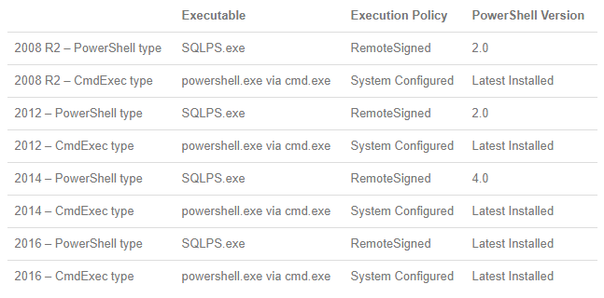
PowerShell & the SQL Server Agent
Thanks to Derik Hammer for this chart!
Notes:
https://www.sqlhammer.com/running-powershell-in-a-sql-agent-job/

Slide 153
PowerShell & the SQL Server Agent
Create a Windows-based Login in SQL Server
Ensure dbatools is available to the account
Create a SQL Server credential
Create the Agent Proxy
Create the PowerShell .ps1 file
Create the Job and Job Step
Schedule the Job

Slide 154
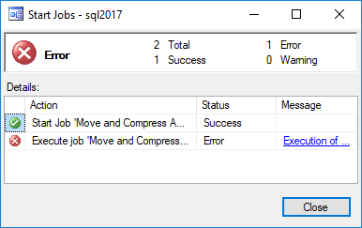
Ensure failed jobs fail
To ensure a job fails, throw a terminating exception
In dbatools, use –EnableException
In most PowerShell commands, use try/catch with –ErrorAction Stop

Slide 155
PowerShell & the SQL Server Agent
dbatools.io/agent

